Slide 1




Exception Handling
Handling Errors During the Program Execution
OOP
SoftUni Team
Technical Trainers
Software University
http://softuni.bg

Slide 2

Table of Contents
What are Exceptions?
Types of Exceptions and their Hierarchy
Handling Exceptions
Best Practices

Slide 3
Questions
sli.do #9986

Slide 4

What are Exceptions?

Slide 5
What are Exceptions?
The exceptions in .NET Framework is a powerful mechanism for centralized handling of errors and unusual events
Simplify code construction and maintenance

Slide 6
The System.Exception Class
The System.Exception class is base for all exceptions in .NET
Contains information for the cause of the error / unusual situation
Message – text description of the exception
StackTrace – the snapshot of the stack at the moment of exception throwing

Slide 7

Exception Properties
Exercises in class

Slide 8

Handling Exceptions

Slide 9
The try-catch Statement
The statement:
try
{
// Do some work that can cause an exception
}
catch
{
// This block will execute if any type of exception occurs
}

Slide 10
The try-catch Statement(2)
try
{
// Do some work that can cause an exception
}
catch(FormatException formatException)
{
// This block will execute only if format exception occurs
}

Slide 11
The try-finally Statement
The statement:
Ensures execution of given block in all cases
When exception is raised or not in the try block
Used for execution of cleaning-up code, e.g. releasing resources
try
{
// Do some work that can cause an exception
}
finally
{
// This block will always execute
}

Slide 12
The try-catch-finally Statement
The statement:
try
{
// Do some work that can cause an exception
}
catch(FileNotFoundException fileNotFoundEx)
{
// This block will be executed only if file not found exception occurs
}
finally
{
// This block will always execute
}

Slide 13
The "using" Statement
In programming we often forget to close our resources.
The “using” statement in C# ensures that resources are always closed properly
using (WebClient webClient = new WebClient())
{
// Use the resource. It will be disposed (closed) at the end
}

Slide 14
Handling Exceptions
Exercises in class

Slide 15
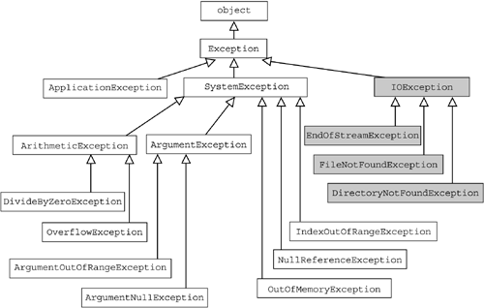
The Hierarchy of Exceptions

Slide 16

Summary
Exceptions provide a flexible error handling mechanism
Each exception handler processes only errors of a particular type (and its child types)
Other types of errors are processed by some other handlers later
Unhandled exceptions cause error messages

Slide 17








Exception Handling
https://softuni.bg/courses/advanced-csharp

Slide 18
License
This course (slides, examples, demos, videos, homework, etc.) is licensed under the "Creative Commons Attribution-NonCommercial-ShareAlike 4.0 International" license
Attribution: this work may contain portions from
"OOP" course by Telerik Academy under CC-BY-NC-SA license

Slide 19






Free Trainings @ Software University
Software University Foundation – softuni.org
Software University – High-Quality Education, Profession and Job for Software Developers
softuni.bg
Software University @ Facebook
facebook.com/SoftwareUniversity
Software University @ YouTube
youtube.com/SoftwareUniversity
Software University Forums – forum.softuni.bg

